Slide 1

PROGRAMACION funcional
Por qué debería interesarte?

Slide 2
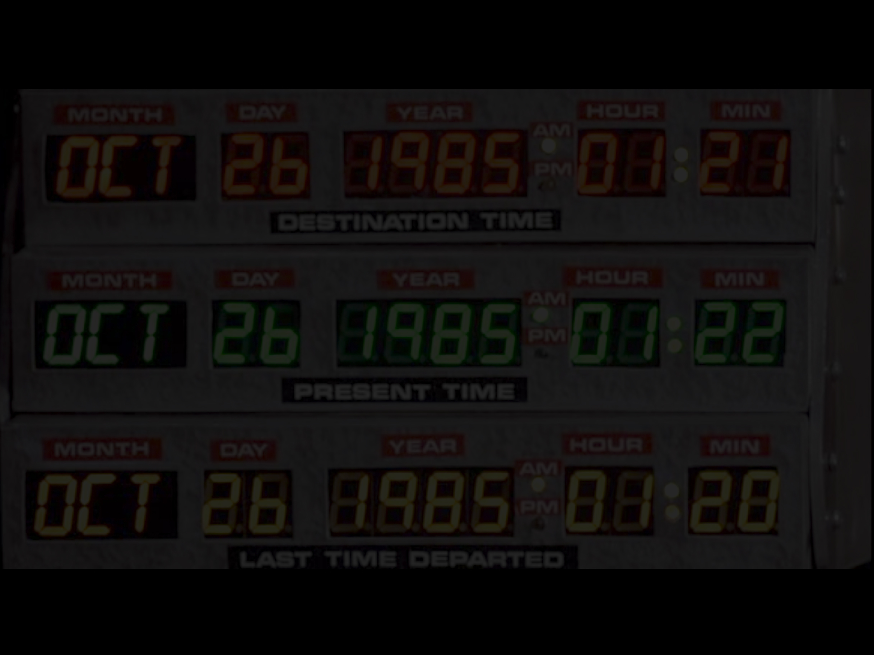
MOTIVACION DE esta charla
Antes de arrancar…

Slide 3
DEFINICION semi-formal
Antes de arrancar…

Slide 4

AGENDA
Que hace a FP relevante?
Features de FP (algunas en JS)
CODIGO!

Slide 5
fp es relevante POR 3 RAZONES

Slide 6

hipster

Slide 7
hipster
Closures
Generics
Garbage collection
Code as data
Monads
Lazy evaluation
Pattern Matching
Lexical Scope

Slide 8
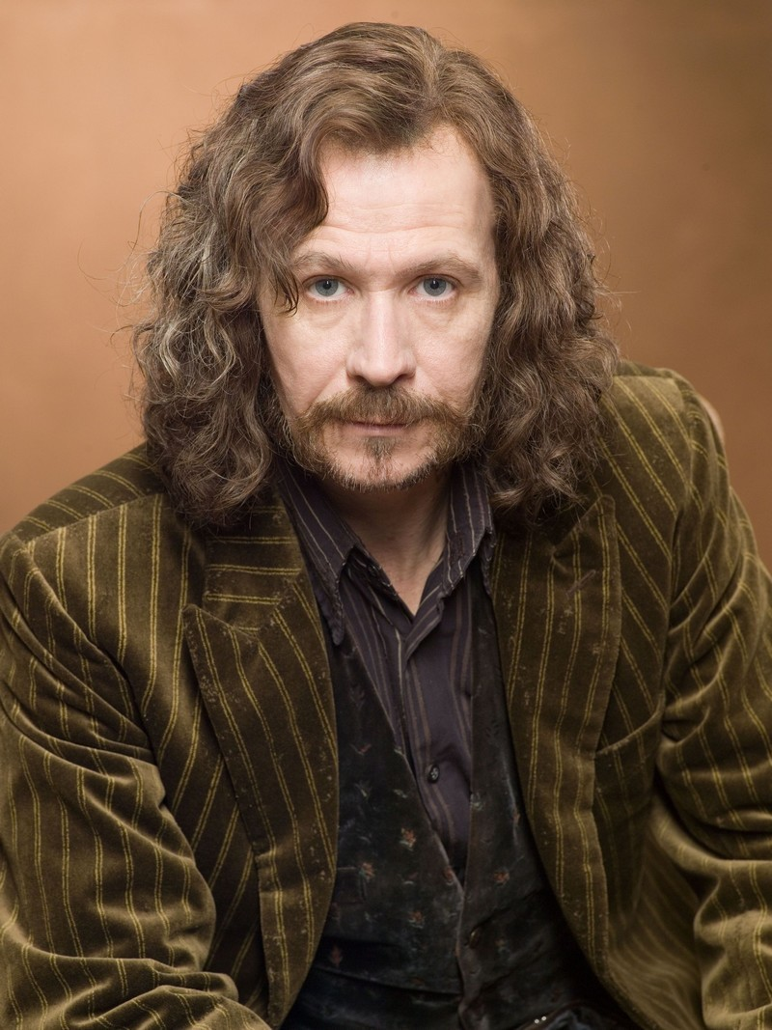

desmitifica

Slide 9
desmitifica
Recursión
Mutabilidad

Slide 10

desmitifica

Slide 11


desmitifica
Rick Hickey
(clojure)

Slide 12
scalabilidad
B M H

Slide 13
scalabilidad
Buy More Hardware

Slide 14
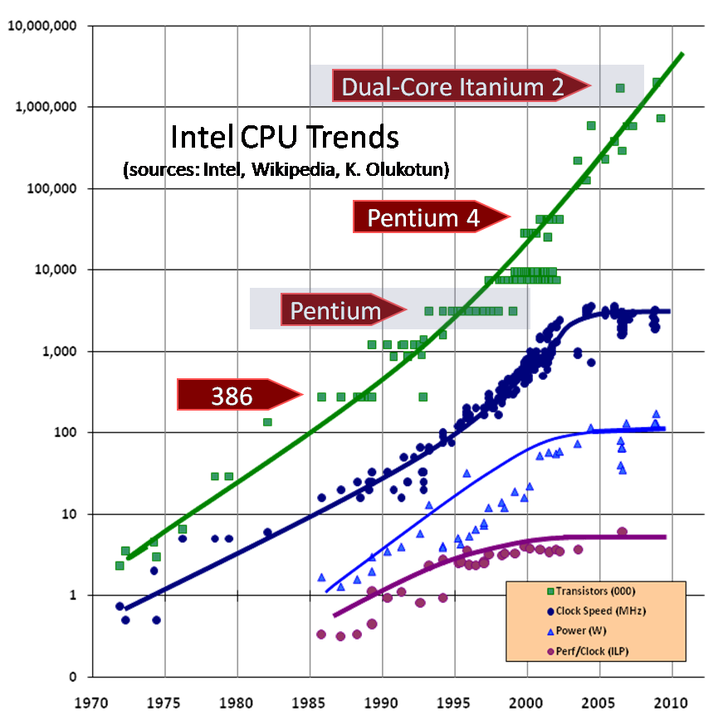
scalabilidad

Slide 15
scalabilidad
Launch More Instances

Slide 16
fp en estado puro (Y TB EN JAVASCRIPT)

Slide 17
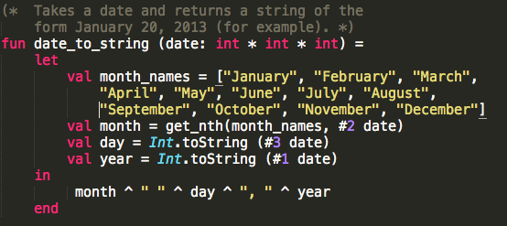
lexical scope

Slide 18
lexical scope
var x = 2, y = 3;
function someAdd() {
var x = 4;
return x + y;
}
someAdd();

Slide 19
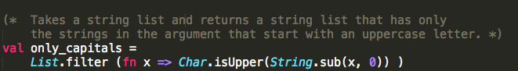
closures

Slide 20
closures
http.get(“www.google.com, function (res) {
....
res.on('data', function(chunk) {
...
}).on('end', function() {
.....
});

Slide 21
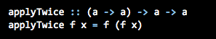
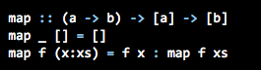
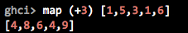
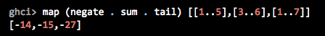
first order functions

Slide 22
first order functions
fn.apply
_.map…
_.compose

Slide 23
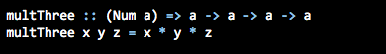
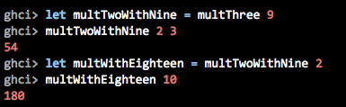
currying

Slide 24
currying
_.partial…

Slide 25
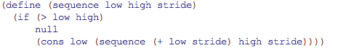
code as data

Slide 26
code as data
{"menu": {
"id": "file",
"value": "File",
"popup": {
"menuitem": [
{"value": "New", "onclick": "CreateNewDoc()"},
{"value": "Open", "onclick": "OpenDoc()"},
{"value": "Close", "onclick": "CloseDoc()"}
]
}
}}

Slide 27
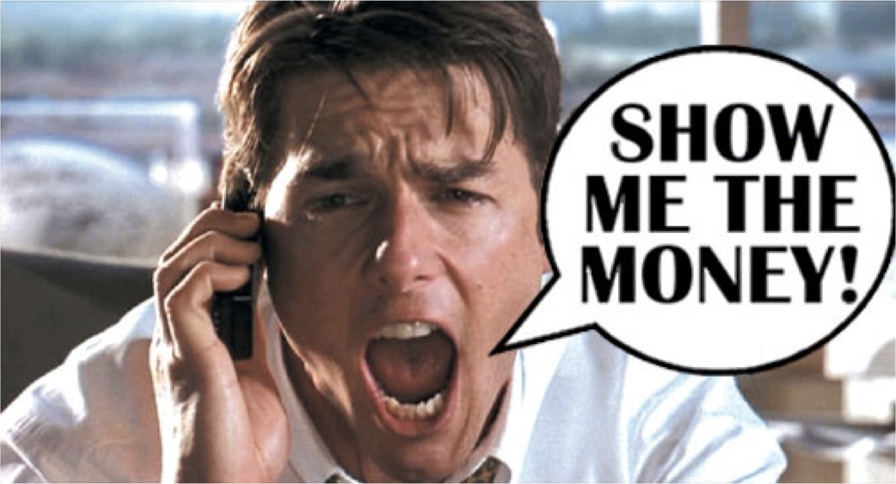

Slide 28
conclusiones

Slide 29
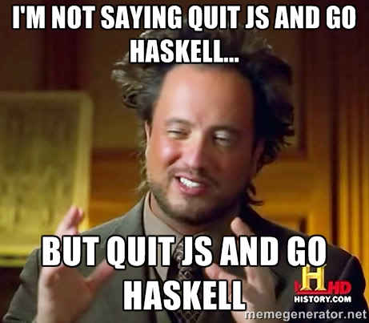

Slide 30
lenguages
Static: ML (primero), Haskell
Dynamic: Racket, Clojure, Scheme (i.e. un Lisp)
Scala???

Slide 31
librerias
Q (https://github.com/kriskowal/q)
RSVP (https://github.com/tildeio/rsvp.js)
FutureJS (https://github.com/FuturesJS/FuturesJS)
Promised-io (https://github.com/kriszyp/promised-io)
Bacon(https://github.com/baconjs/bacon.js)
Fn.js(http://eliperelman.com/fn.js/)
Wu (http://fitzgen.github.io/wu.js/)
Fnky (https://github.com/leoasis/fnky)
Prelude (http://preludels.com/)

Slide 32
ver y leer
“Hey Underscore, you’re doing it wrong”
http://www.youtube.com/watch?v=m3svKOdZijA
“How to survive asynchronous programming in JS”
http://www.infoq.com/articles/surviving-asynchronous-programming-in-javascript
“Callbacks are imperative, Promises are Functional”
https://blog.jcoglan.com/2013/03/30/callbacks-are-imperative-promises-are-functional-nodes-biggest-missed-opportunity/
“Promises/A spec”
http://wiki.commonjs.org/wiki/Promises/A

Slide 33
temas
Monads
Currying/Partial/Compose/Point-free
Beneficios de no mutar
Promises/Futures
Subtyping/Generics
Lazyness
Librerías
Soporte nativo

Slide 34
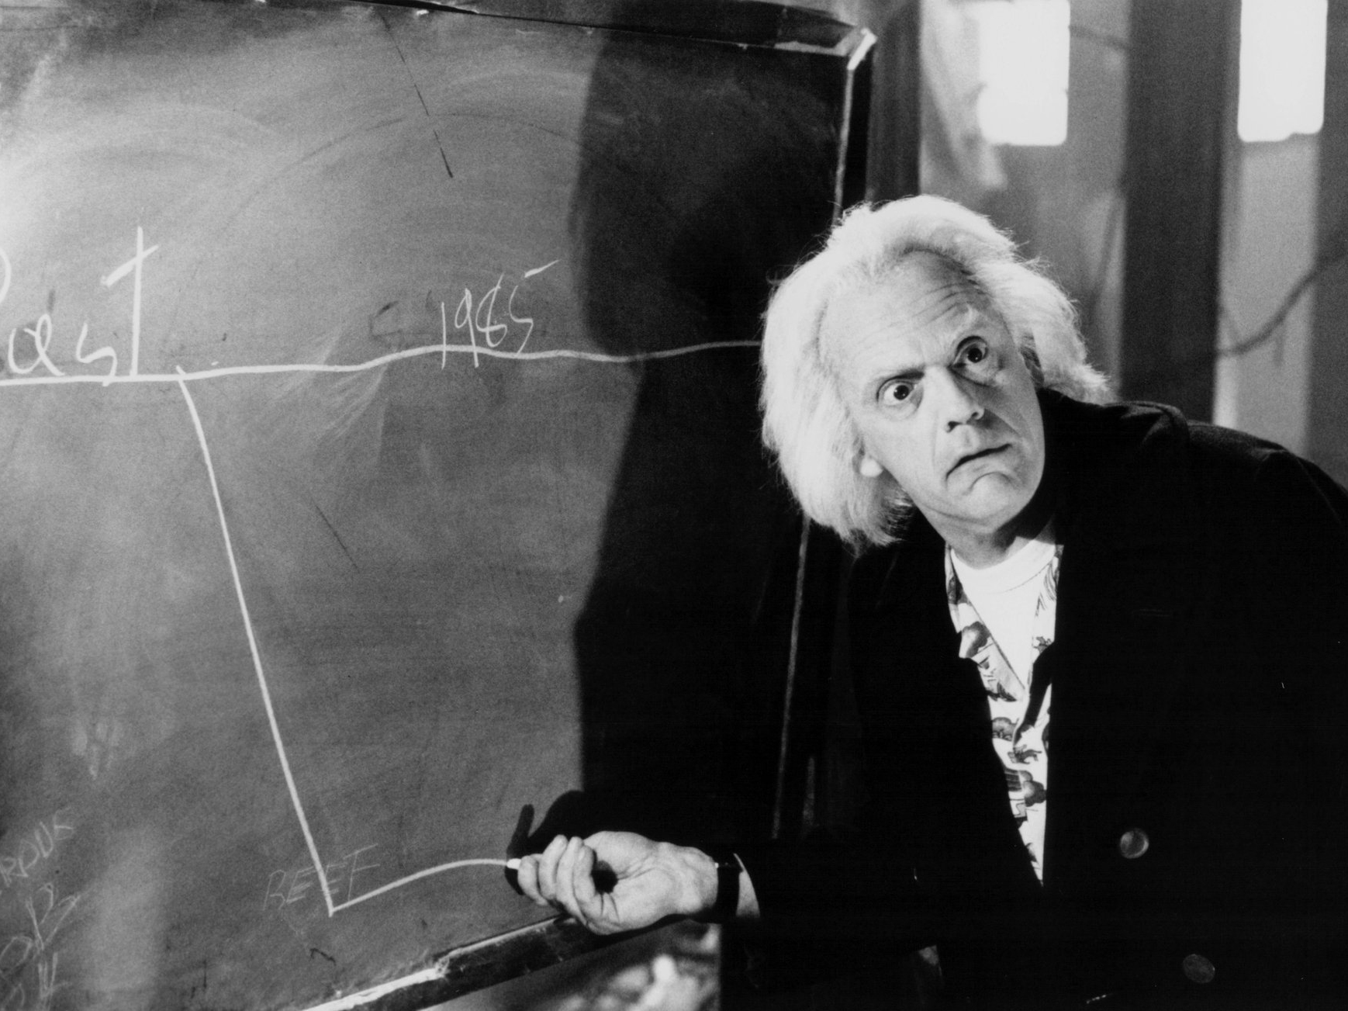

Slide 35
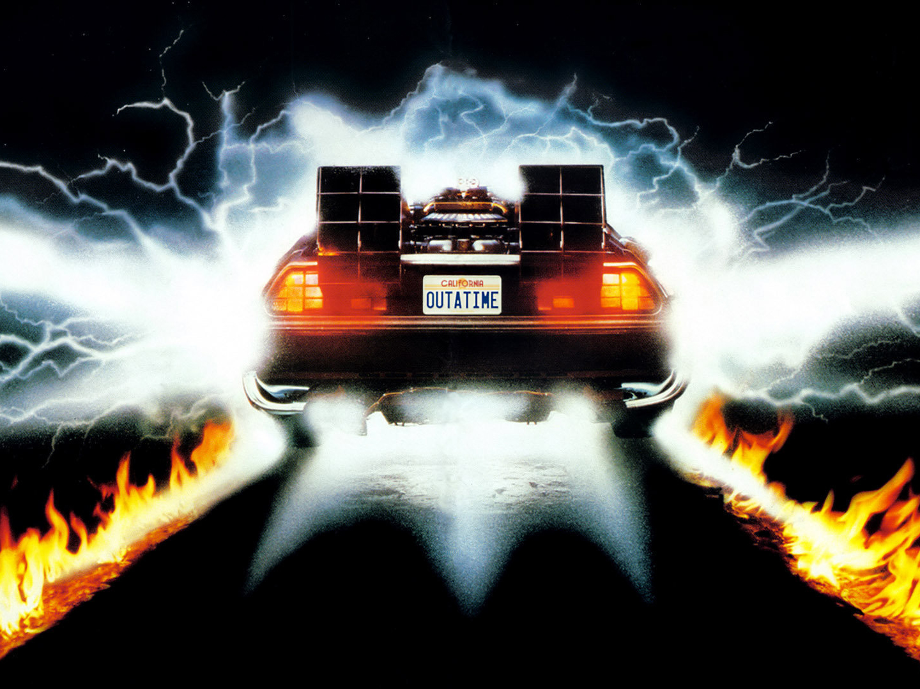
github.com/holden-caulfield/
@jpsaraceno
GRACIAS!

